Slide 1



Democratic and Popular Republic of Algeria
Ministry of Higher Education and Scientific Research
University of Abdelhamid Mehri – Constantine 2
Faculty of New Technologies of Information and Communication (NTIC)
Department of Software Technologies and Information System
BACHELOR’S THESIS
Final Project for Obtaining of a Bachelor’s Degree in Computer Science
Option: Software Engineering

Slide 2



TOWARD BUILDING A SECURE COMPETITIVE LEARNING
PLATFORM FOR COMPUTER SCIENCE TECHNICAL CHALLENGES
AACADEMY
Presented by:
Touati Mohamed Amine
Ababsa Aymen
Gueblie Ayoub Abdessami
Supervised by:
Dr.Naila Marir

Slide 3

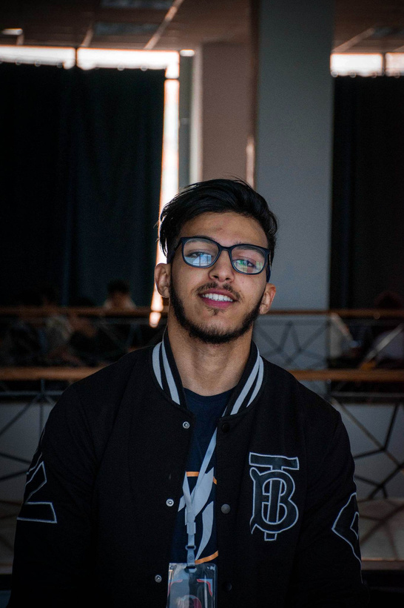
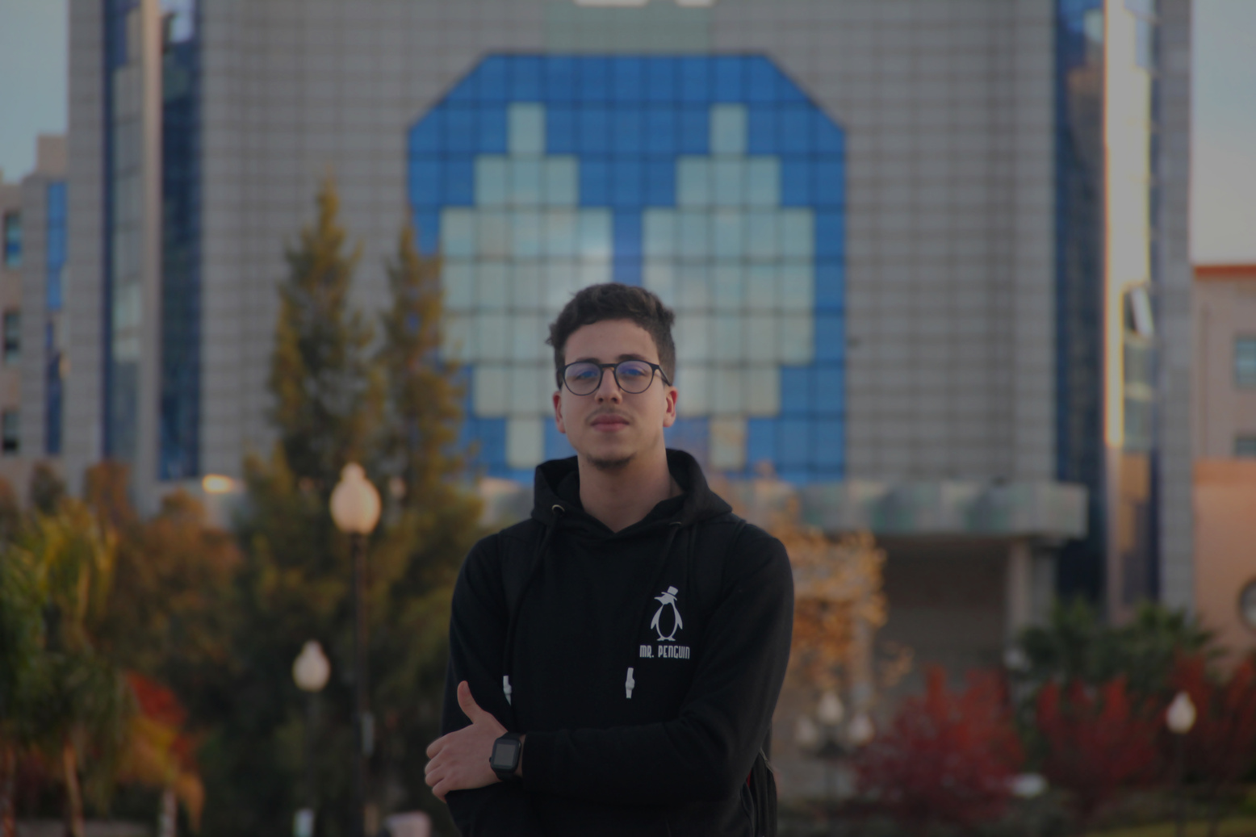
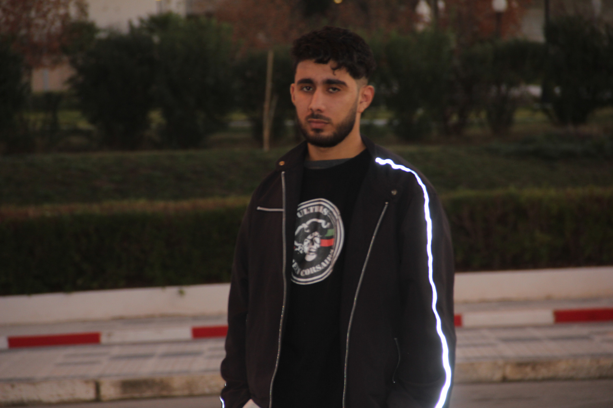

Our team
Touati Mohamed Amine
Ababsa Aymen
Gueblie Ayoub Abdessami
L3 software engineering student
L3 software engineering student
L3 software engineering student

Slide 4


Context
In the ever-evolving world of computer science, practicality plays a crucial role in driving innovation and translating theoretical concepts into real-world solutions. To address this opportunity for growth, a groundbreaking web application is being developed specifically for cybersecurity practitioners. The envisioned application aims to bridge the gap between theoretical knowledge and practical application by providing comprehensive tools, resources, and challenges. Its focus on cybersecurity will offer curated challenges, simulations, and real-world scenarios to reflect the dynamic nature of the field. The application will also foster collaboration and community engagement through discussion forums, knowledge-sharing platforms, networking and job opportunities. By simplifying and enhancing the programming practice experience, the web application aims to empower professionals with the skills and expertise needed to protect digital ecosystems from evolving threats.

Slide 5

Our Solution
Project 1
(MAIN Project)
Project 2
Our goal is to create an innovative website that not only offers joy and eliminates boredom but also makes education easily accessible to all. We believe that learning should be a delightful and engaging experience, and our platform aims to bring that vision to life.
Our vision is to develop an innovative mobile app that not only brings joy and eliminates boredom but also makes education easily accessible to users on the go. We understand that people today are constantly connected to their mobile devices, and we want to leverage this accessibility to offer a delightful and engaging learning experience.

Slide 6

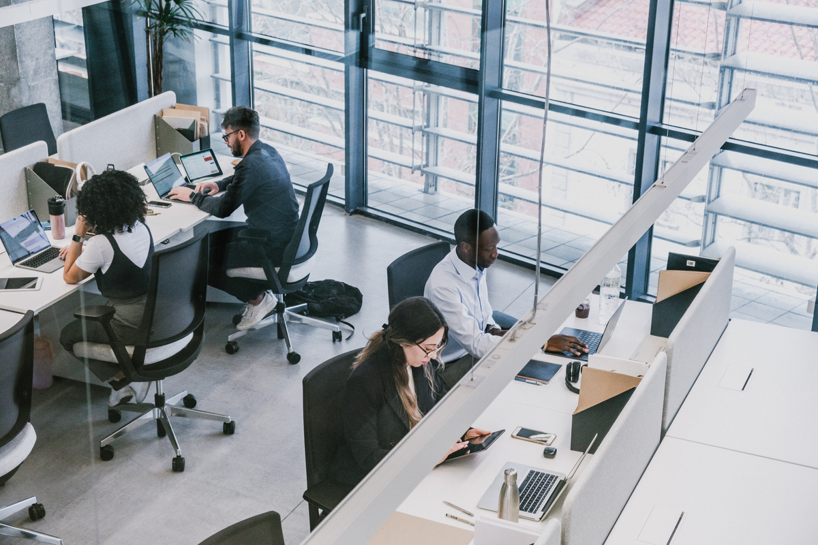

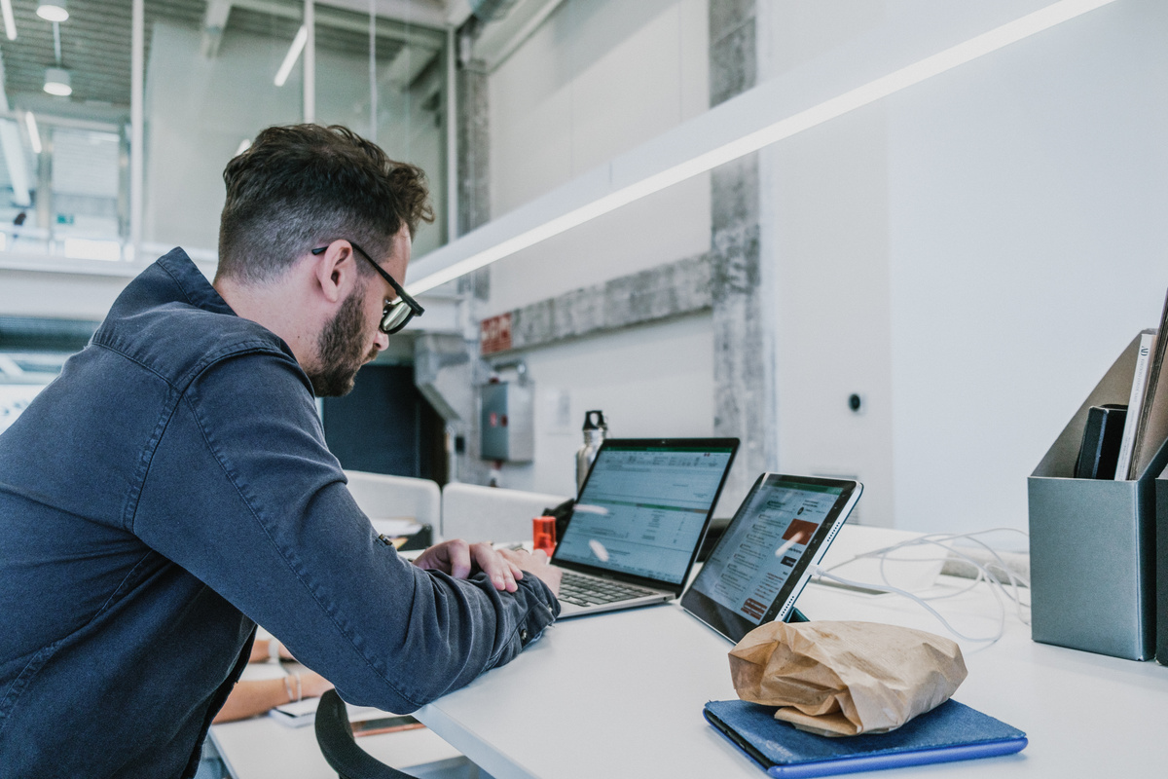
Our Goals
Accessibility
Empowerment
EffiKnowledge Sharingciency
Engagement and Motivation
The platform may aim to make complex challenges or tasks more accessible to a wider audience. By simplifying the process or providing user-friendly interfaces, it can lower barriers and enable individuals with varying levels of expertise to participate.
The platform may seek to empower users by providing them with tools, resources, or guidance to overcome challenges more easily. It can offer educational materials, tutorials, or step-by-step instructions to help users navigate complex tasks and build confidence in their abilities.
The platform may facilitate the sharing of expertise, experiences, and best practices among users. By connecting individuals with diverse backgrounds and skills, it can create a collaborative community where knowledge is exchanged, and collective intelligence is leveraged to tackle challenges effectively.
Simplifying challenges can help maintain user engagement and motivation. By providing a sense of progress, feedback, and rewards, the platform can make tasks more enjoyable and fulfilling. It may incorporate gamification elements, social interactions, or incentives to encourage users to persist in overcoming challenges.

Slide 7






Our main features
2FA
Validation
System
Interview By link
Compitition
is a security measure used to enhance the protection of digital accounts and systems. It adds an extra layer of security by requiring users to provide two different types of authentication factors to verify their identity.
validation systems are utilized to assess whether a software application or system meets its intended requirements and specifications. This involves executing tests, simulations, or user trials to verify that the software functions as intended, produces expected outputs, and operates correctly under various scenarios.
These challenges often require quick thinking, decisive action, and the ability to adapt on the spot. They can occur in various contexts, such as personal, professional, or technical environments. Here are a few examples of real-time challenges:
These challenges often require quick thinking, decisive action, and the ability to adapt on the spot. They can occur in various contexts, such as personal, professional, or technical environments. Here are a few examples of real-time challenges:

Slide 8
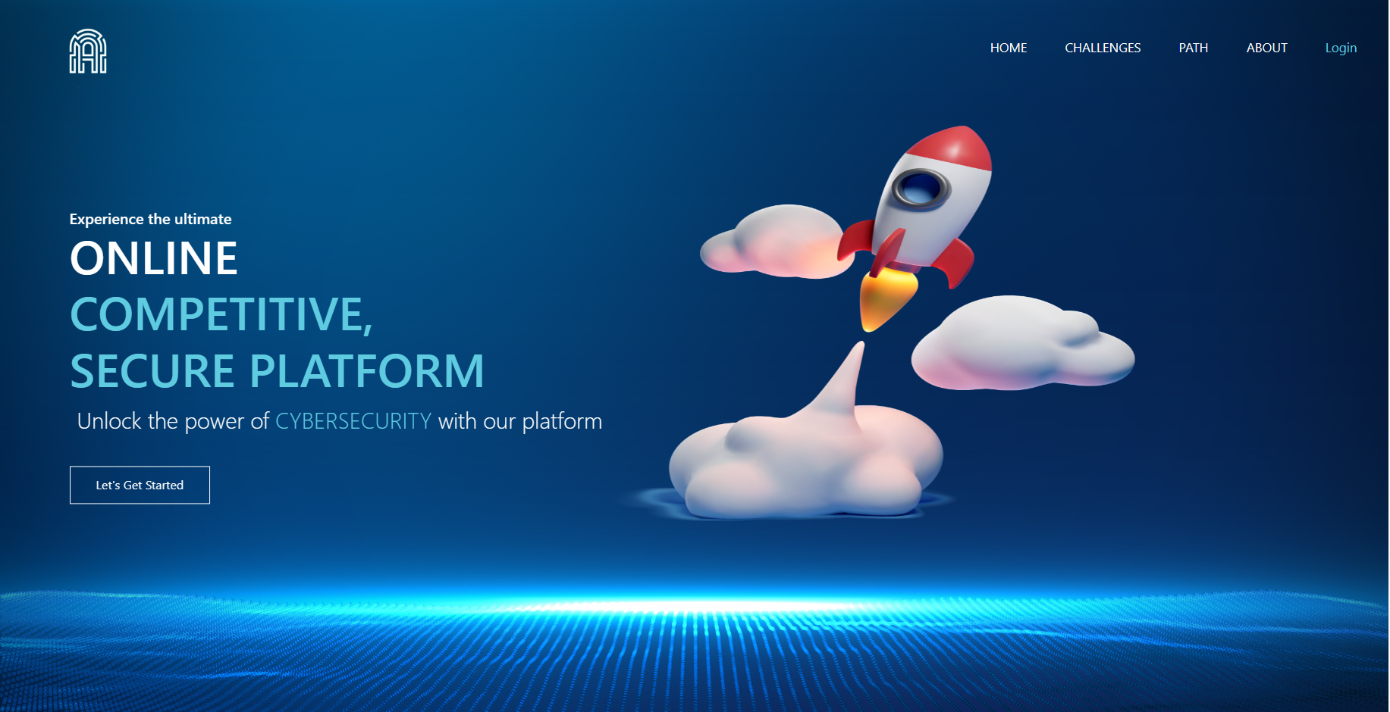

Slide 9
THANK YOU
For watching this presentation

